Slide 1
MODULE -1 Topics Covered:OS,FUNCTIONS OF OS,DESIGN APPROACHES,TYPES OF OS

Slide 2
What is an Operating System??
A program that acts as an intermediary between a user of a computer and the computer hardware.
Operating system goals:
Execute user programs and make solving user problems easier.
Make the computer system convenient to use.
Use the computer hardware in an efficient manner.

Slide 3
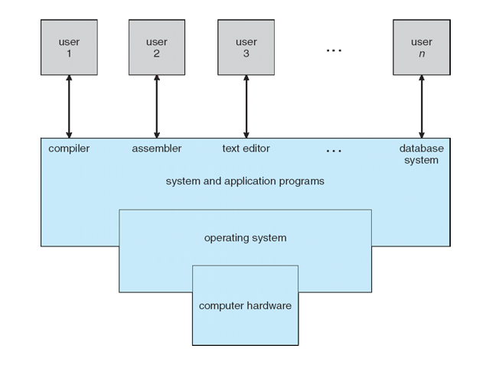
Four Components of a Computer System

Slide 4
FUNCTIONS OF AN OPERATING SYSTEM -2 BASIC FUNCTIONS
1.Resource Management
a.Resource-files,CPU,main memory,i/o devices etc
b.allocate it to users
Functions
a.Time Management( CPU and Disk Scheduling)
b.Space Management(Memory and Secondary storage)
c.Process Syncronization and deadlock handling
d.Accounting and status information

Slide 5
2.User friendliness
a.Hides the low level details of the machine
b.Provides a friendlier user interface
For eg users of virual machines have the illusion that each one is the owner of the machine,even though the machine may operate in a multiuser environment.
User execution encompass the following tasks
a.Execution environment
b.Error detection and handling
c.Protection and security
d.Fault tolerance and failure recovery

Slide 6
Design approaches
1.Layered Approach
2.The Kernal based Approach
3.The virtual machine approach

Slide 7
What should be done and how should be done
Policies-cpu scheduling
Mechanisms-means to implement various scheduling disciplines and policy decides which CPU discipline(fcfs,sjfs,priority)
A good operating system design must separate policies from mechanisms.
policy may change from time to time

Slide 8
1.Layered approach
Proposed by Dijstra –to lessen the complexities of OS
7 layers
Same as ISO –OSI MODEL in networks.
Has all the advanatges of modular design-each layer can be designed,coded and tested independently.
OS functions should be carefully assigned to each layers-because a layer can make use only of the functionality provided by the layers beneath it.

Slide 9
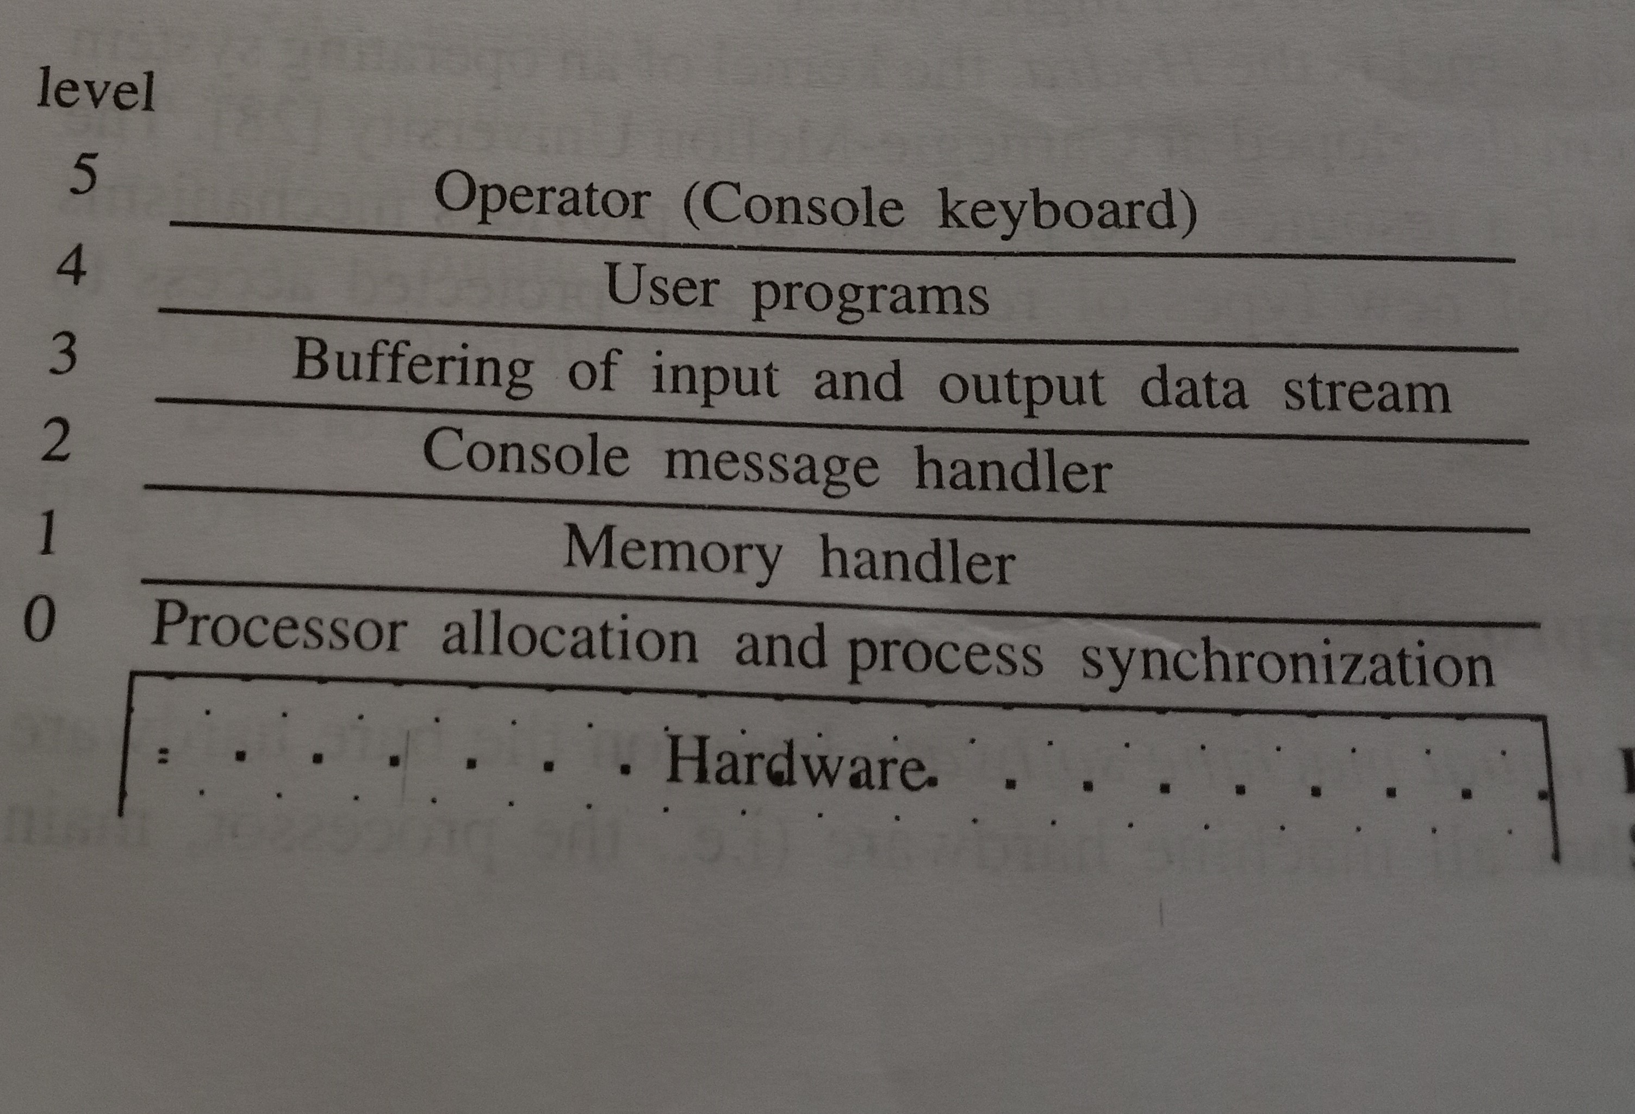

Slide 10
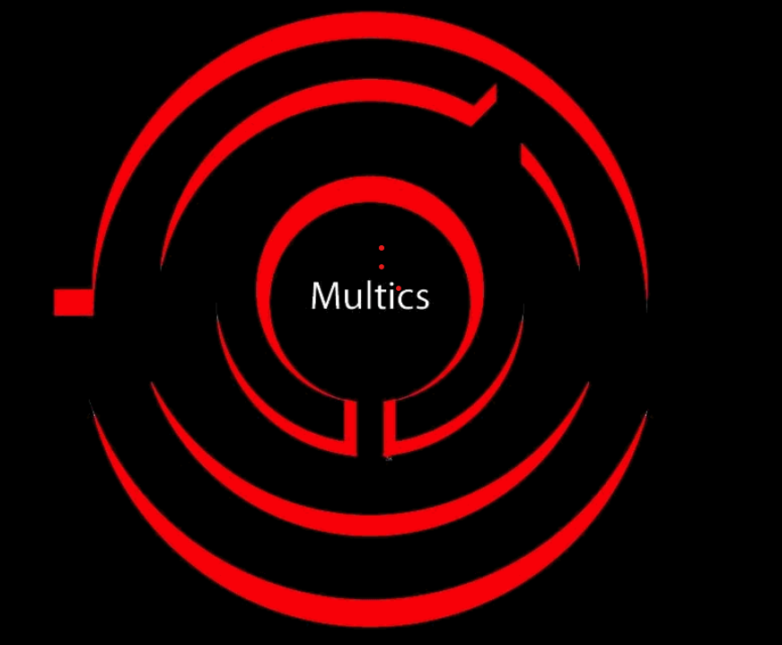
Multics system(early time sharing OS)-structured as several concentric circles
*Ring structure is used
*Serves as an aid in designing and implementing protection
*privilege decreases from inner ring to successive outer ring

Slide 11
Multics-Multiplexed Information and Computing Service
Based on single level memory

Slide 12
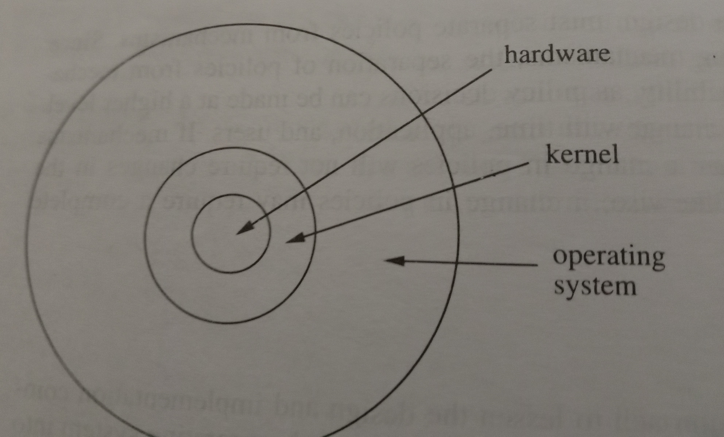
2.The kernel based approach
Suggested by Brinch Hansen
Kernal –collection of primitive facilities over which the rest of the OS is built .
Policy and mechanism are not buit here
Only mechanism
Policy decisions should be left to outer layer

Slide 13
According to Hansen a kernel is a fundamental set pf primitives that allows the dynamic creation and control of the process as well as communication among them.
Supported only the notion of process and not the idea of resource
Hydra OS-supports both process and resource

Slide 14
The virtual Machine Approach
Virtual machine software layer that runs on bare hardware
A Virtual Machine (VM) is a compute resource that uses software instead of a physical computer to run programs and deploy app
Entire instruction set is executed using privileged instructions.
VM creates illusion by appropriately time multiplexing the system resource among all the users of machine
Can also run a Single OS.
Eg IBM 370 system wherein VM s/w,VM/370 provides a VM to each user

Slide 15
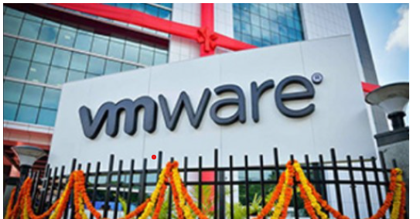

Slide 16
Types of Advanced OS
Advanced os
Architecture Driven
Application Driven
Distributed system
Multiprocessor System
Database system
Real Time System

Slide 17
Distributed OS
Multiprocessor OS
Database OS
Real time OS

Slide 18
Distributed OS
Network of autonomous computers connected by a communication network
Controls the whole system such that entire system is viewed as a powerful monolithic system
User is not aware where the program is executed or of the location of the resources accessed.
Lack of shared memory and a physical global clock, communication delays

Slide 19
Multiprocessor OS
Tightly coupled system which share the same address space
Address space- amount of memory allocated for possible address of a computational enity,such as a device, file, server of network computer
Powerful uniprocessor system

Slide 20
Database OS
DBMS places special requirement on OS
Should support the concept of transaction, store and retrieve,concurrency control

Slide 21
Real Time OS
jobs have completion deadlines
Hard and soft RTOS
Hard Real Time System : Hard real time is a system whose operation is incorrect whose result is not produce according to time constraint.Eg medical system
Soft Real Time System : Soft real time system is a system whose operation is degrade if results are not produce according to the specified timing requirement.Eg Games
The major issue is scheduling on OS in a particular way that max number of jobs satisfy deadlines

